Slide 1
Energy Review
Subtitle

Slide 2
Energy and Countries
Compare energy consumption of contemporary society with that of traditional cultures
Compare Canada’s per-capita energy consumption with developed and developing nations and ID factors that affect consumption (i.e. economy, lifestyle, level of technology, geography and climate)

Slide 3
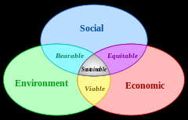
Sustainability
Apply sustainable development to increasing efficient use of energy

Slide 4
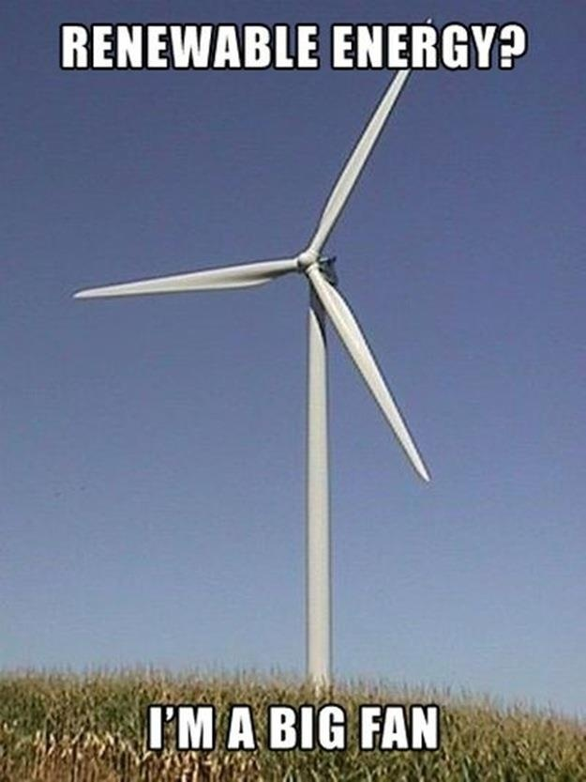
Renewable and Non-renewable Energy
Explain the need to develop technologies that use renewable and non-renewable energy in the home and to meet increasing global demand

Slide 5
Describe the environmental impact of developing and using various energy sources (i.e. conventional oil, oil sands, solar power, biomass, hydroelectricity, nuclear power and geothermal power, wind power)
Type of Energy Source | Environmental Impact
Conventional Oil
Oil Sands
Solar Panels
Biomass
Hydroelectric
Nuclear
Geothermal
Wind

Slide 6
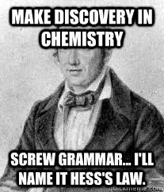
Hess
Explain how Hess’s Law leads to the theoretical prediction of heat of combustion. Use the formula to calculate the energy released in reactions

Slide 7
Energy Conversions
Describe the conversion of solar energy into renewable forms (i.e. wind, hydro, chemical potential energy by photosynthesis) and non-renewable forms (i.e. coal, oil and gas) and further conversions into electrical and thermal energy
Describe the functioning of renewable energy technologies and assess their advantages and disadvantages, including active and passive solar heating technologies, wind turbines, hydroelectric power, biomass energy hydrogen fuel cells

Slide 8
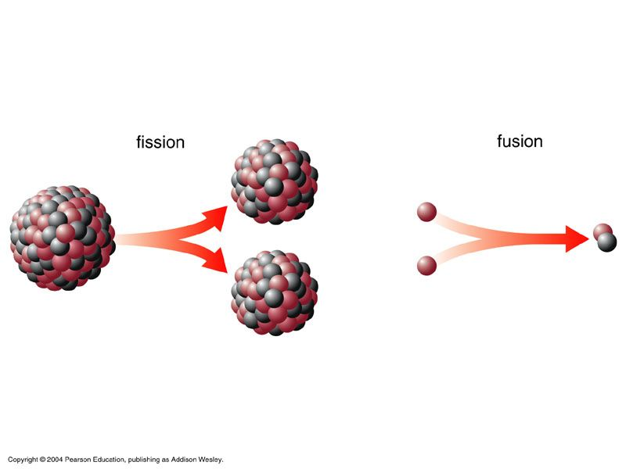
Nuclear Reactions
Explain the difference between fission and fusion and balance simple nuclear reactions to show the conversions of nucleons

Slide 9
Nuclear Reactions

Slide 10
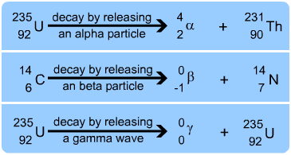
Decay
Describe and demonstrate radioactive decay including alpha, beta and gamma radiation

Slide 11
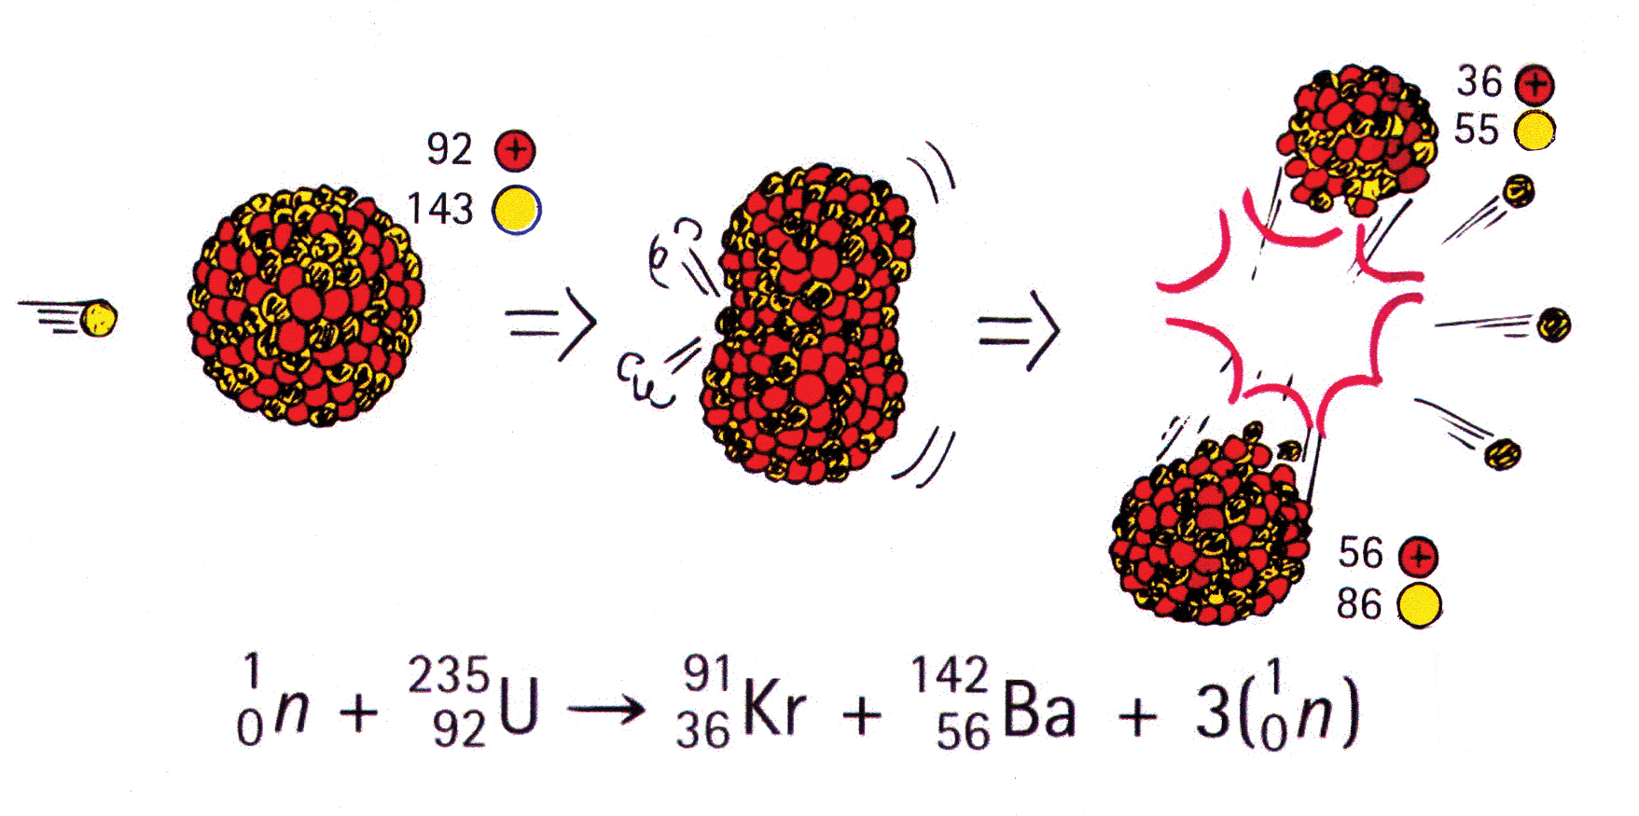
E=mc²
Describe mass energy changes in fission and fusion reactions and use E=mc²

Slide 12
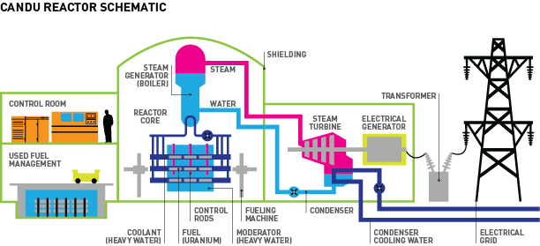
CANDU
Describe the operation of a fission reactor (CANDU)

Slide 13
Energy Conversions
Compare and contrast coal or hydroelectric power stations with nuclear power stations, in terms of purpose, process of energy conversions, design and function
Explain the source of tides, in terms of gravitational attraction and the relative motions of the sun, moon and Earth
Describe the energy transformations involved in converting tidal energy to electrical energy

