Slide 1
Physics Review
Subtitle

Slide 2
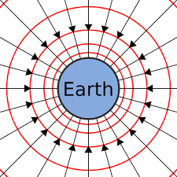
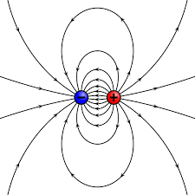
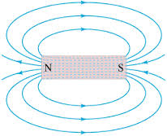
Fields
Describe and calculate strength of field around a mass (i.e. electric field, magnetic field, gravitational field) and understand that if a mass is introduced into this region it will experience a force
Compare source, direction and strength of vector fields as determined by test objects

Slide 3
Fields
Calculate field strength and attractive forces within a field (gravitational and electric field strength at a given distance from a mass or point charge using equations)
Describe how radius, mass and charge can effect the field strength

Slide 4
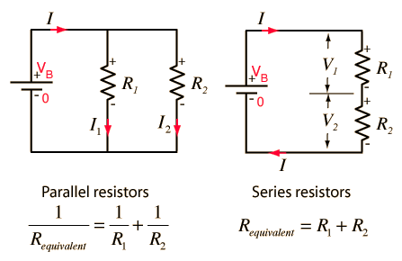
Circuits
Describe the relationship for up to 3 resistors among power, current, voltage and resistance for both series and parallel circuits using equations

Slide 5
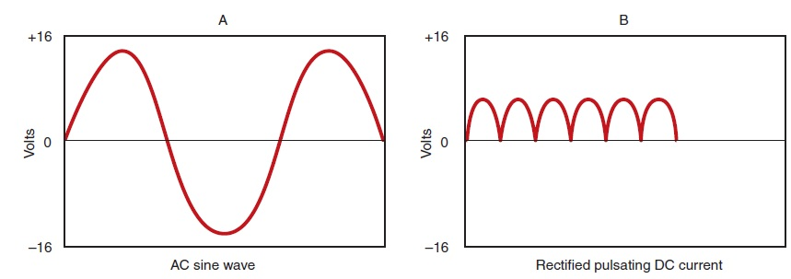
AC vs DC
Distinguish between alternating current and direct current in terms of electron flow and electric field
Describe advantages of AC over DC for transmitting and using electrical energy

Slide 6
Transformers
Describe the operation of a transformer in terms of the relationship among current, voltage and number of turns in the primary and secondary coils

Slide 7
Energy Calculations
Describe electrical energy in kilowatt hours and joules using equations

Slide 8
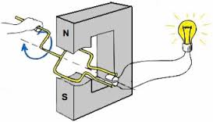
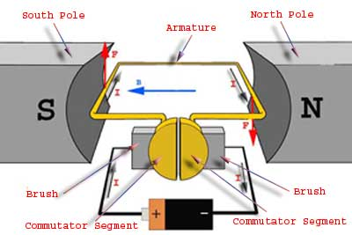
Generators and Motors
Compare the general design and function of a DC electric motor and generator (be able to label and describe how they work)

Slide 9
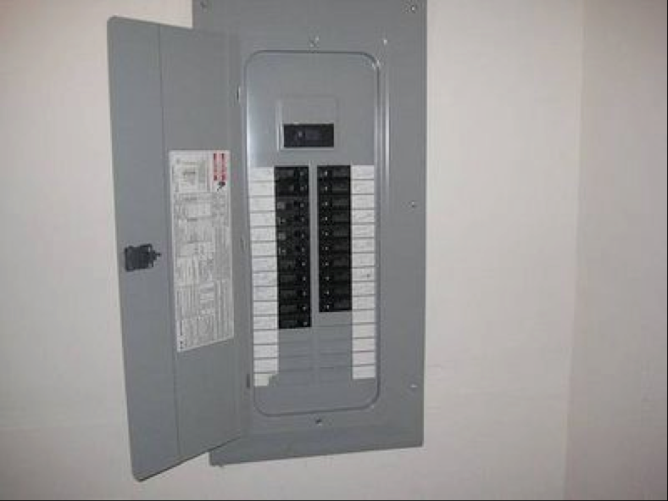
Safety
Describe in terms of designs and electrical energy, the functioning of safety technologies like circuit fuses and breakers, polarized plugs and ground wirings

Slide 10
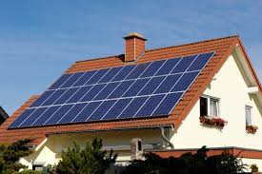
Energy at home
Describe examples of technological devices based on electric current (i.e. lightbulbs, electrical devices and electromagnets in the home and workplace) and their effect on everyday life (i.e. cost of energy)

Slide 11
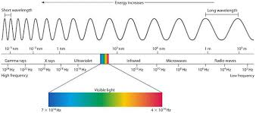
EMR
Describe the range of the electromagnetic spectrum from long, low frequency radio waves through microwaves, infrared rays, visible light and ultraviolet radiation to very short, high frequency waves such as Xrays and gamma rays and compare in terms of source, frequency, wavelength, energy and effect on living tissue and properties of these above EMRs

Slide 12
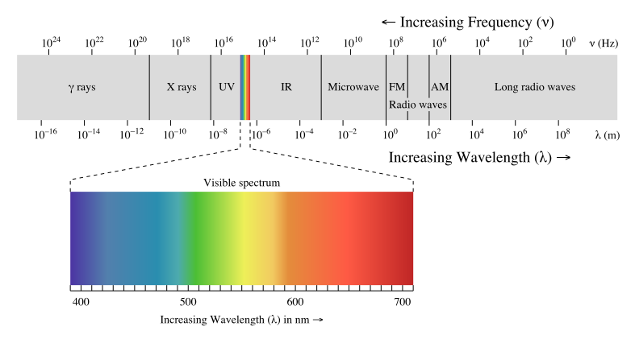
EMR

Slide 13
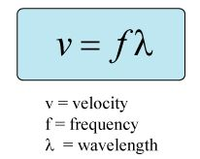
Wave equation
Investigate, use and describe the relationship of the variables in the universal wave equation

Slide 14
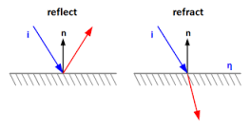
Waves
Recognize that the earth’s atmosphere absorbs certain frequencies of EMR
Investigate and describe reflection, refraction, diffraction and polarization of visible light

Slide 15
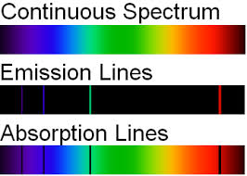
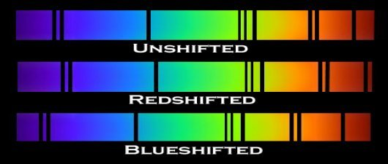
Spectroscopy
Describe how a spectroscope can be used to determine the composition of stars and conditions to produce emissions (bright line) and absorption (dark line) spectra in terms of light sources and temp
Describe technology used in star study
Spectroscopes used to analyze the distribution of energy in a star’s continuous emission spectrum
Analyze shifts in the spectrum in terms of Red and Blue shift (Doppler effect)

Slide 16
Stars
Describe the evolution of stars and the existence of black holes, white dwarves and neutron stars

Slide 17
EMR Technologies
Explain the goal of technology is to provide solutions to practical problems (i.e. uses of EMR to solve medical problems using MRIs, Xrays, laser surgery) and describe technologies developed to protect astronauts from high-energy radiation

