Slide 1
Chemistry Review

Slide 2
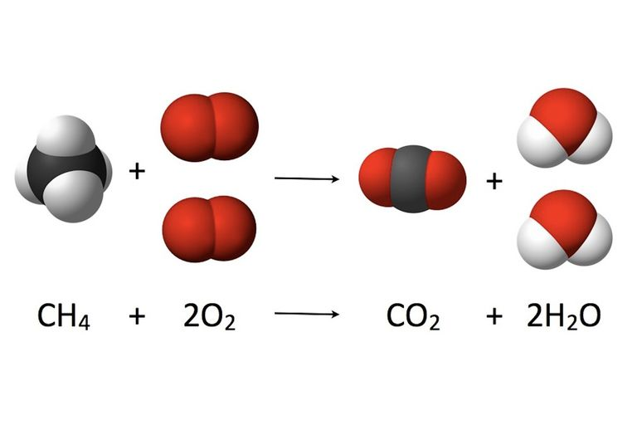
Combustion Reactions
Reactants and products
Balancing
Hydrocarbons
Emissions
Fuel
Balancing equations
Oxides
Sulfur, nitrogen and carbon
Incomplete vs. Complete combustion
Particulate Matter

Slide 3
Acids and Bases
Acids and bases
What are some descriptors of acids/bases
Titrations
How to calculate an unknown concentration
Bronsted-Lowry definition of acids and bases
Arrhenius’s definition of acids and bases
Limitations of the theory
Acid base indicators and distinguishing strength of acid and base

Slide 4
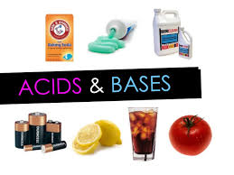
Acids and Bases
Properties
Taste
pH
Arrhenius Definition (H+ and OH-)
Litmus Color

Slide 5
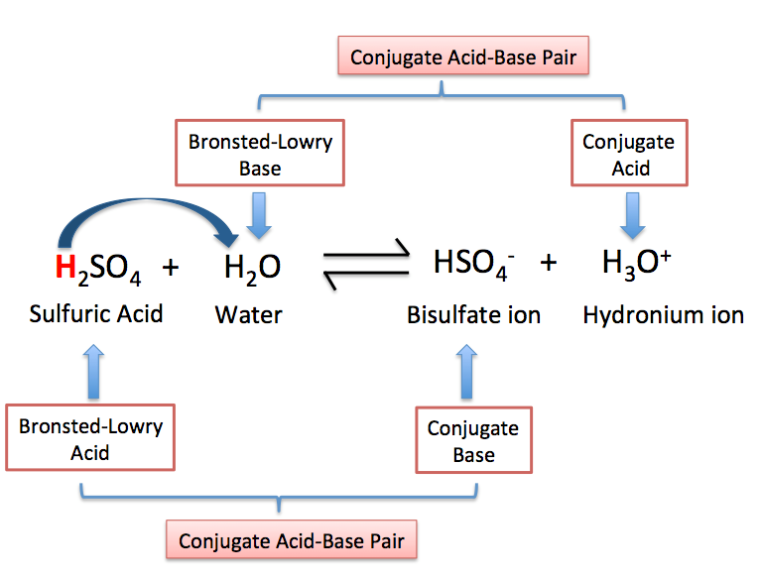
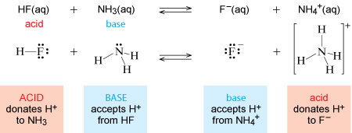
Bronsted-Lowry Acids and Bases

Slide 6
Titrations
Given two variables and a chart
Find Unknown using C_{A}V_{A}=C_{B}V_{B}
Chart
Trial | 1 | 2 | 3 | 4
Initial Volume of Base | 0.10mL | 20.10mL | 34.10mL | 0.10mL
Final Volume of base | 20.10mL | 34.10mL | 50.20mL | 14.3mL
Difference

Slide 7
Calculating pH and the pH scale
Solving for concentration and pH

Slide 8
Additional Acid info
Acid Deposition and effects
Jet Stream
Lime stone vs. Sedimentary Rock
Metal Leaching
Plant nutrients
Expressing concentrations (ppm and ppb)
Reducing Emissions
Scrubbers
Catalytic Converters
Photochemical Smog

Slide 9
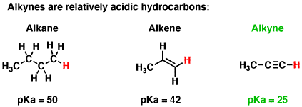
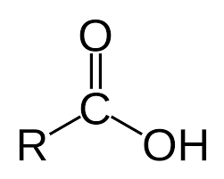
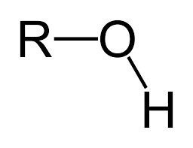
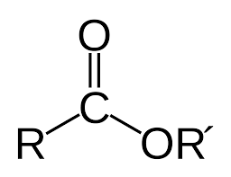
Organic Compounds
Alkane, Alkene, Alkyne
Halogenated Hydrocarbons
Process of Ozone Depletion (CFC’s)
Alcohols
Esters
Carboxylic Acids
Polyesters and bio-plastics

Slide 10
Organic Issues
Bio-magnification
Understanding Exposure
Off-gassing
Pesticides
Target specificity
Drift
Grasshopper effect
Persistence

