Slide 1
Biology Review
Subtitle

Slide 2
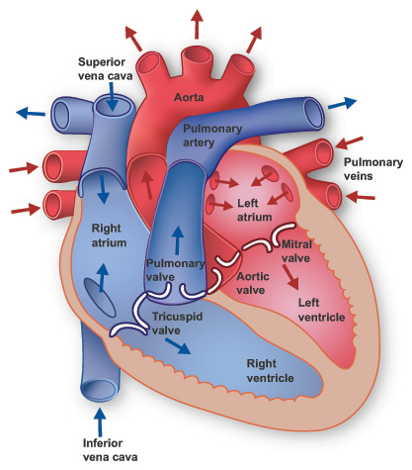
Circulatory System
Anatomy of the Heart
  Vena Cava (inferior and superior)
  Right/Left Atrium
  Right/Left Ventricle
  Pulmonary Artery/vein
  Aorta
  Valves (generally)
  Oxygenated and non-oxygenated
  Blood flow through heart

Slide 3
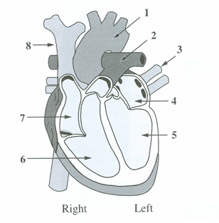
Example
The heart pumps both oxygenated and deoxygenated blood. Which of the structures labeled above contain oxygenated blood?
Answer: ________ _______ _______ _______

Slide 4
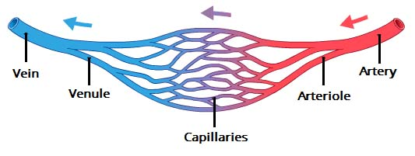
Blood Vessels
Artery, Veins, Capillaries
  Direction, oxygen content, structure (elasticity vs. valves), pressure

Slide 5
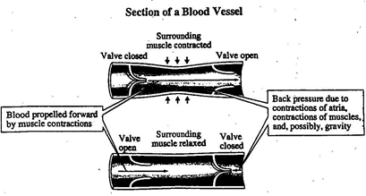
Example
The type of blood vessel depicted in the diagram is
A. a vein
B. an artery
C. a capillary
D. arteriole

Slide 6
Example
During chemotherapy, a drug is injected into a vein in the patient’s arm. The sequence in which the drug moves through the four parts of the circulatory system listed above is ______, ______, ______, and ______.

Slide 7
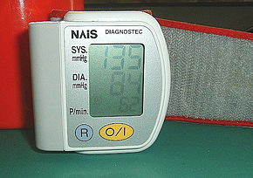
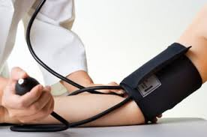
Blood Pressure
Systolic and Diastolic
Reading heart pressure
Using a Sphygmomanometer
Factors affecting blood pressure
Factors affecting heart rate

Slide 8
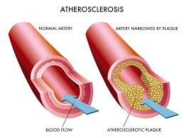
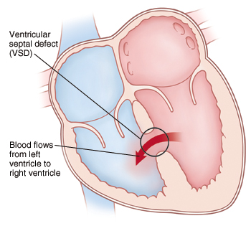
Cardiovascular Diseases and other medical issues
Varicose Veins
Atherosclerosis, arteriosclerosis, angina, aneurysm, heart attack, stroke, septal heart defect
LDL vs HDL

Slide 9
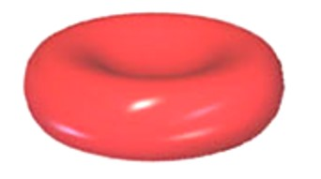
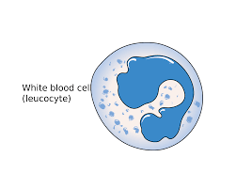
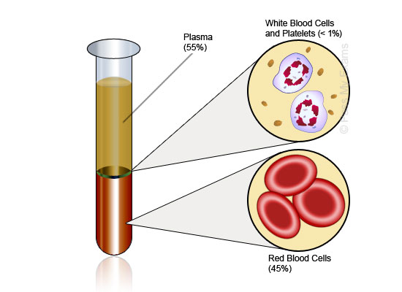
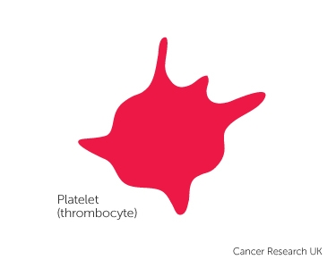
Components of blood
Component | Role | Percentage | Shape
Red blood cell (Erythrocytes) | Carrying hemoglobin which can carry oxygen | ~45%
White Blood Cell (leukocytes) | Fighting infections | <1%
Platelets (Thrombocytes) | The clotting process | <1%
Plasma | Carrying ions Holds blood cells in suspension | ~55% | N/A

Slide 10
Example
Doctors and technicians at a medical clinic treat and counsel patients and carry out technical procedures during their daily routines.
Blood clotting factors are routinely tested. Clotting is initiated by
platelets
helper T cells
red blood cells
white blood cells

Slide 11
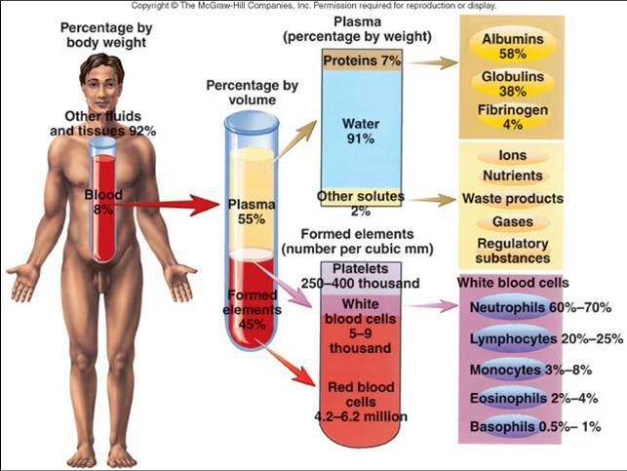
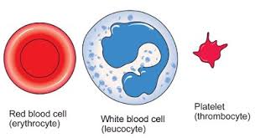
Components of Blood

Slide 12
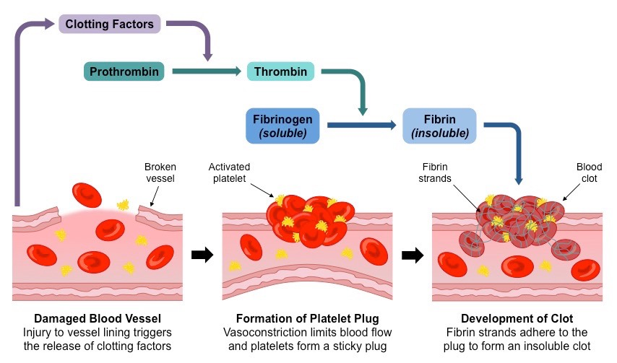
Clotting Process

Slide 13
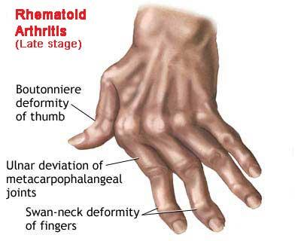
Immune System
First lines of defense
  Skin, hair, stomach pH, eye lashes
How do diseases spread?
  Pathogens, protozoans, viruses, vectors
  Autoimmune Disease
    Rheumatoid Arteritis, allergies, anaphylactic shock

Slide 14
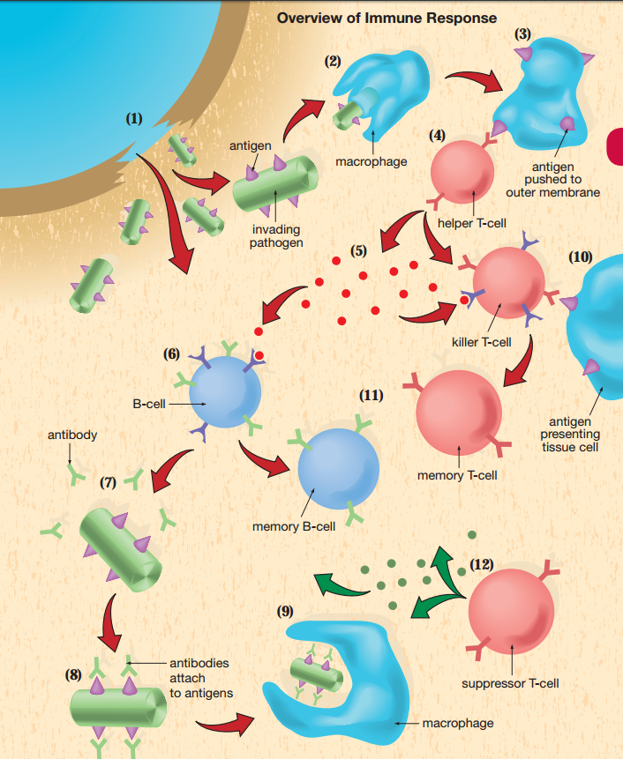
Immune Response
Macrophages
Antigens
T Cells
  Helper
  Killer
  Memory
  Suppressor
B Cells
  Antibody

Slide 15
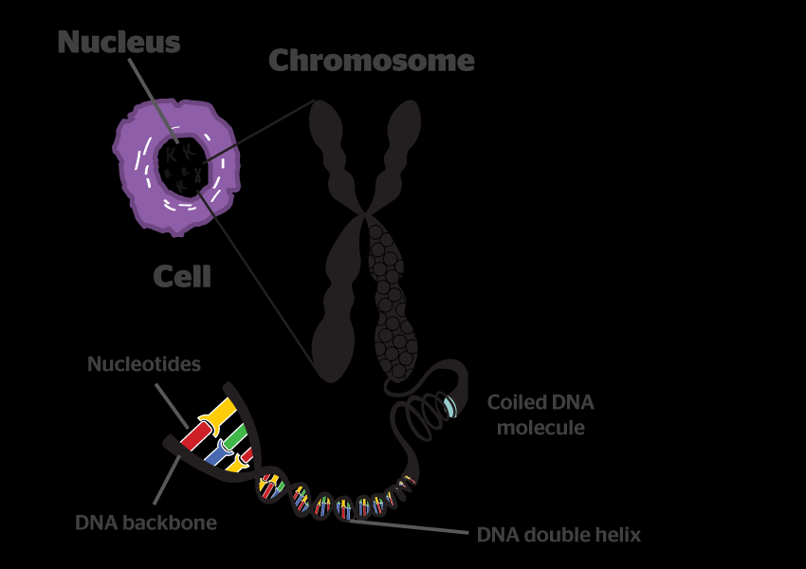
Chromosomes
Location
Number in humans

Slide 16
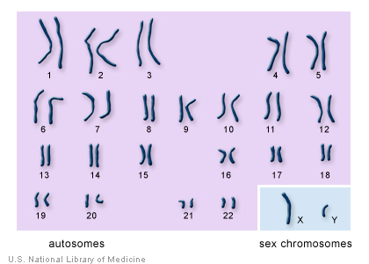
Karyotyping
Genetic Disorders
  21-down syndrome
Reading Pair 23

Slide 17
Mitosis and Meiosis
Type | Mitosis | Meiosis
Cells made | Autosomal Cells | Sex cells
Number of Separations | 1 | 2
Daughter Cells | 2 | 4
Name of cells made | Diploid Cells | Haploid cells
Chromosomes in daughter cells (human) | 46 | 23

Slide 18
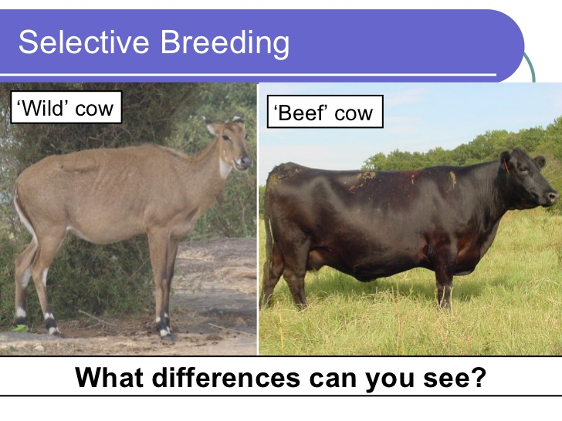
Selective Breeding

Slide 19
Genetics Dominant vs Recessive Genes
Dominant vs Recessive Genes
Punnett Squares
Homozygous vs Heterozygous
Genotype vs Phenotype
Sex linked traits

Slide 20
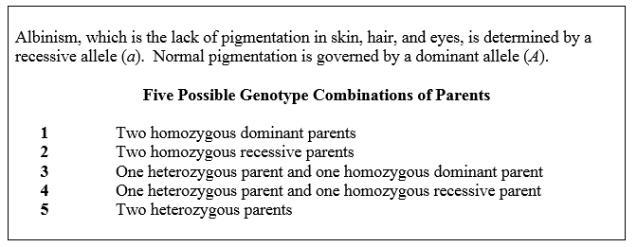
Example
The sets of parents listed above that could produce a child who has normal pigmentation are those numbered ______, ______, ______, and ______.

Slide 21
Example
Which of the following crosses would provide the greatest probability for albinism in the offspring?
AA × aa
Aa × Aa
Aa × aa
Aa × AA

Slide 22
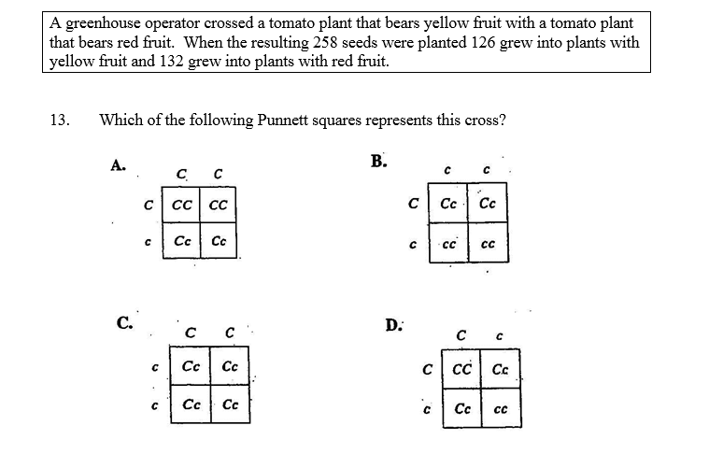
Example

Slide 23
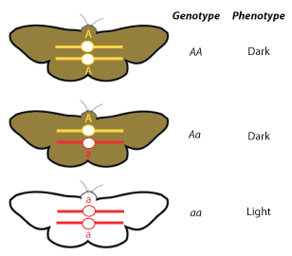
Genotypes and Phenotypes
Genotype
  Heterozygous, homozygous
    Bb, BB, rr
Phenotypes
  Blonde hair, color-blind

Slide 24
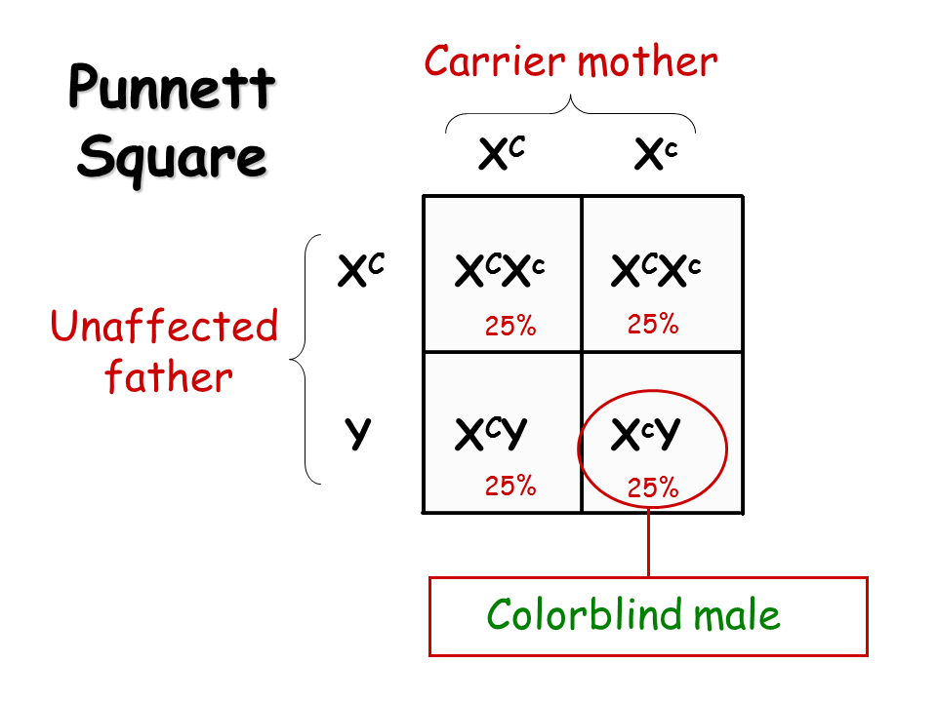
Sex-linked
Female XX
Male XY

Slide 25
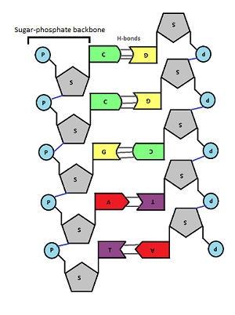
DNA
Structure, Nucleotides
  Cytosine, Guanine, Adenine and Thymine
  Amino Acids (Triplets) and Protein Synthesis

Slide 26
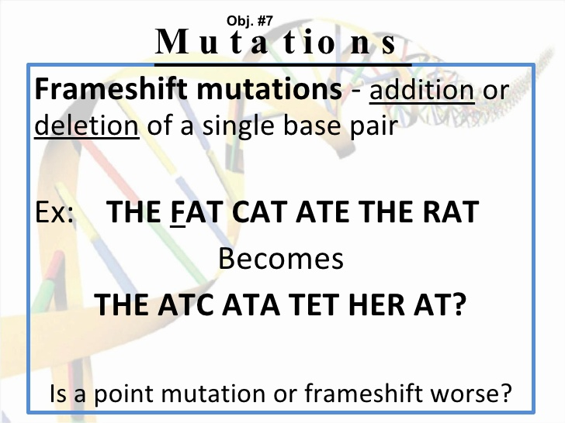
Mutations
Mutation/Mutagen Examples
  Point Mutation
  Frameshift Mutation
    Addition
    Deletion
Pedigree Charts
Genetic Diseases
  Cystic Fibrosis
  Huntington's disease
  Hemophilia
  Beneficial Mutations

Slide 27
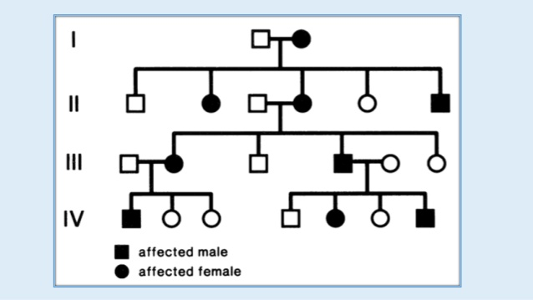
Pedigree Charts

Slide 28
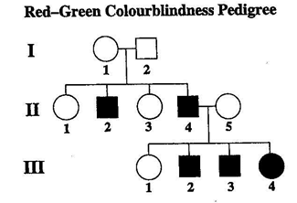
Example
1. A doctor used the colorblindness pedigree above to trace red-green colorblindness in a family. According to this pedigree, how many women in the family are colorblind?
A. one
B. four
C. five
D. none
2. The genotype and phenotype of II-5 are, respectively,
A. homozygous and colorblind
B. heterozygous and colorblind
C. homozygous and not colorblind
D. heterozygous and not colorblind

Slide 29
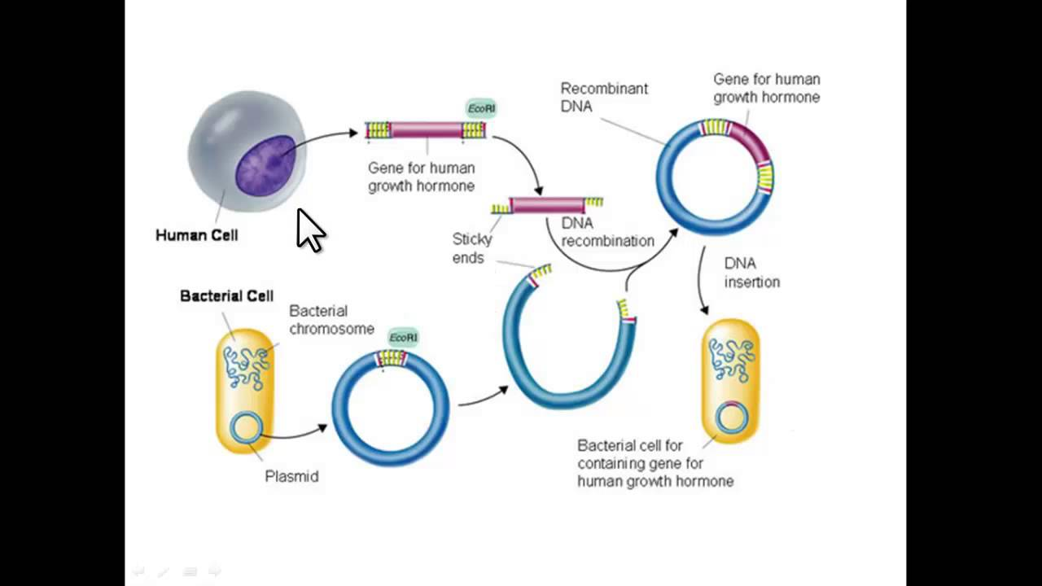
Gene Technologies
Transgenic
  Genetic Engineering
Recombinant DNA
Gene Therapy

